Slide 1


Python for Cloud Engineers
Expert Level
Dated: 14 June 2025
Instructor : Fawad Bahadur
Github: bahadurCorvit

Slide 2

Agenda
01
Introduction
05
Evaluate models with proper metrics
02
Learn end-to-end ML pipeline
06
Use pipelines and cross-validation
03
Implement classification, regression, clustering
07
Tune models with GridSearchCV
04
Apply preprocessing techniques
08
Complete a mini ML project

Slide 3

Course Introduction
Course Duration: 4–6 Weeks (Project-Based)
Prerequisites: Intermediate Python, Cloud Fundamentals (AWS/Azure/GCP)
Target Audience: Cloud Architects, DevOps Engineers, Site Reliability Engineers (SREs)

Slide 4
What You’ll Learn:
Automating cloud tasks with Python
Working with SDKs like boto3, google-cloud, and azure
Infrastructure-as-Code using Python
Event-driven/serverless computing with Python
Monitoring and Logging (e.g., CloudWatch, Stackdriver)
Writing APIs with FastAPI/Flask for microservices

Slide 5
Setting Up Your Python Cloud Environment
Tools Required:
Python 3.8+ (Recommended: 3.10+)
pip / conda for package management
Git for version control
VS Code / PyCharm
Cloud CLI tools:
AWS CLI
Azure CLI
Google Cloud SDK (gcloud)

Slide 6
Common Python Libraries:
boto3 – AWS SDK
google-cloud-* – GCP SDKs
azure-identity, azure-mgmt-resource – Azure SDKs
requests, httpx – API calls
fastapi, flask – Lightweight APIs
paramiko, fabric – SSH and remote execution

Slide 7
Python Refresher – Focused for Cloud
Essentials to Master:
Functions (including *args, **kwargs)
Working with files and directories (os, pathlib)
Exception handling (try, except, finally)
Working with JSON and YAML (json, PyYAML)
Environment variables (os.environ)

Slide 8
Conti…
Working with APIs:
requests.get(), post()
Parsing responses
Authentication headers

Slide 9
Conti…
Working with External Services:
HTTP, sockets, and subprocess modules
Using subprocess.run() for CLI automation
Advanced Built-ins (Cloud-Relevant):
contextlib, functools, dataclasses
Writing decorators for cloud function handlers

Slide 10
Cloud SDKs with Python – Overview
AWS (Amazon Web Services):
Library: boto3
Services: EC2, S3, Lambda, CloudWatch, IAM
Example: Create an S3 bucket with Python
Azure:
Library: azure-identity, azure-mgmt-resource, azure-storage-blob
Services: VM, Storage, Azure Functions, Monitor
Example: Upload files to Azure Blob using Python

Slide 11
Conti…
Google Cloud Platform (GCP):
Library: google-cloud-storage, google-cloud-compute
Services: GCE, GCS, Cloud Functions, Pub/Sub
Example: Launch VM using Python SDK
Authentication with SDKs:
AWS: .aws/credentials or boto3.Session
GCP: GOOGLE_APPLICATION_CREDENTIALS
Azure: DefaultAzureCredential, ClientSecretCredential

Slide 12




Hands-On with AWS SDK (boto3)
What is boto3?
Official Python SDK for AWS
Enables you to create, configure, and manage AWS services via Python
Common Use Cases:
Create/delete S3 buckets
Launch/terminate EC2 instances
Invoke Lambda functions
Manage IAM users/roles
Sample Code: Create an S3 Bucket
Authentication:

Slide 13
Hands-On with AWS SDK (boto3)
Stored in ~/.aws/credentials or use boto3.Session()
Also supports IAM roles for EC2 and Lambda
Sample Code: Create an S3 Bucket
import boto3
s3 = boto3.client('s3')
s3.create_bucket(Bucket='my-cloud-python-bucket')
Authentication:
Stored in ~/.aws/credentials or use boto3.Session()
Also supports IAM roles for EC2 and Lambda

Slide 14
Working with Azure SDK in Python
Sample Code: Create an S3 Bucket
import boto3
s3 = boto3.client('s3')
s3.create_bucket(Bucket='my-cloud-python-bucket')
Authentication:
Stored in ~/.aws/credentials or use boto3.Session()
Also supports IAM roles for EC2 and Lambda

Slide 15


Built-in Datasets
Scikit-Learn Provides Sample Datasets
from sklearn.datasets import load_iris
data = load_iris()
print(data.feature_names)
Popular Built-in Datasets:
load_iris() – flower classification
load_digits() – handwritten digits
load_diabetes() – regression task
load_breast_cancer() – binary classification

Slide 16
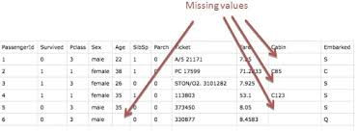
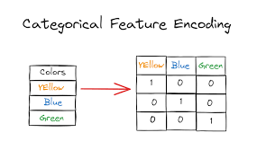
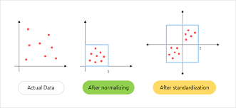
Data Preprocessing in Scikit-Learn
Why Preprocess?
To ensure data is clean, consistent, and suitable for training.
Common Preprocessing Tasks:
Handling missing values
Encoding categorical features
Feature scaling/normalization
Key Modules:
from sklearn.preprocessing import StandardScaler, LabelEncoder
from sklearn.impute import SimpleImputer

Slide 17
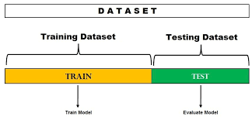
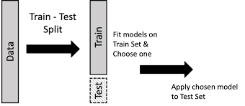
Train-Test Split
Why Split Data?
To evaluate the model's performance on unseen data.
Function Used:
from sklearn.model_selection import train_test_split
X_train, X_test, y_train, y_test = train_test_split(
X, y, test_size=0.2, random_state=42)
Parameters:
test_size: Proportion of test data (e.g., 0.2 = 20%)
random_state: Ensures reproducibility
Goal:
Prevent overfitting by using separate test data

Slide 18
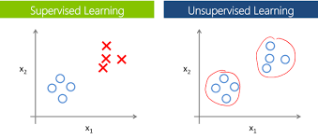
Supervised vs Unsupervised Learning
Two Main Types in Scikit-Learn
🎓 Supervised Learning:
Learn from labeled data
🔍 Unsupervised Learning:
Discover hidden patterns
Type | Description | Examples
Supervised | Input and labeled output | Classification, Regression
Unsupervised | Only input data, no labels | Clustering, Dimensionality Reduction

Slide 19
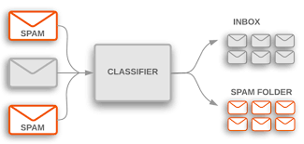
Supervised Learning – Classification
What is Classification?
Predicting a discrete label or category.
Popular Classification Models in Scikit-Learn:
LogisticRegression
KNeighborsClassifier
DecisionTreeClassifier
RandomForestClassifier
SVC (Support Vector Classifier)
NaiveBayes (GaussianNB)
Example Use Cases
Email spam detection
Disease diagnosis
Image recognition

Slide 20
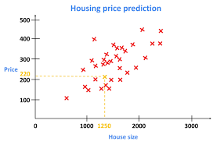
Supervised Learning – Regression
What is Regression?
Predicting a continuous numerical value.
Popular Regression Models in Scikit-Learn:
LinearRegression
Ridge, Lasso
SVR (Support Vector Regression)
DecisionTreeRegressor
RandomForestRegressor
Example Use Cases
House price prediction
Stock price forecasting
Sales estimation

Slide 21
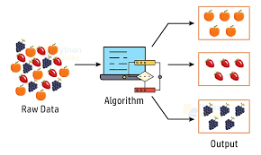
Unsupervised Learning – Clustering
What is Clustering?
Grouping similar data points without labels.
Popular Clustering Algorithms in Scikit-Learn:
KMeans
DBSCAN
AgglomerativeClustering
Example Use Cases
Customer segmentation
Social network analysis
Market basket analysis

Slide 22
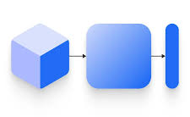
Unsupervised Learning – Dimensionality Reduction
What is Dimensionality Reduction?
Reducing the number of input features while preserving important information.
Popular Techniques in Scikit-Learn:
PCA (Principal Component Analysis)
TruncatedSVD
t-SNE (for visualization)
Example Use Cases
Visualizing high-dimensional data
Speeding up ML models
Removing multicollinearity
Fewer dimensions → Faster training + Less overfitting

Slide 23
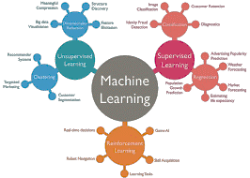
Model Selection in Scikit-Learn
Choosing the Right Model
Depends on:
Type of problem (classification, regression, clustering)
Size and nature of dataset
Performance goals (accuracy, speed, interpretability)
Scikit-Learn Helps With:
Wide variety of models
Easy model switching
Same interface: .fit(), .predict()
Try multiple models & compare performance!

Slide 24
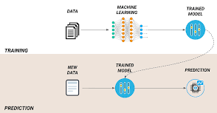
Training a Model
Basic Steps to Train a Model
from sklearn.linear_model import LinearRegression
model = LinearRegression()
model.fit(X_train, y_train)
What Happens During .fit()?
Learns the relationship between input X_train and output y_train
Stores model parameters (like weights)
All models in sklearn follow:
model.fit(X_train, y_train)
predictions = model.predict(X_test)

Slide 25
Making Predictions
Once Trained, Use the Model to Predict
y_pred = model.predict(X_test)
What Happens?
The model uses learned parameters
Applies them to unseen X_test data
Returns predicted values (y_pred)
Used for:
Evaluating performance
Making real-world decisions
✅ Works the same way for classification & regression

Slide 26
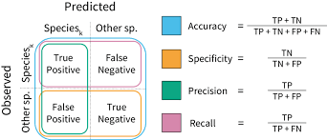
Model Evaluation – Classification Metrics
How Well Did the Model Perform?
Key Classification Metrics:
Accuracy – Correct predictions / Total predictions
Precision – True Positives / (True Positives + False Positives)
Recall – True Positives / (True Positives + False Negatives)
F1 Score – Harmonic mean of precision and recall
Confusion Matrix – Visual performance breakdown
Scikit-Learn Tools:
from sklearn.metrics import accuracy_score, precision_score, recall_score, f1_score, confusion_matrix

Slide 27
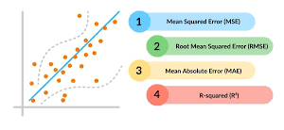
Model Evaluation – Regression Metrics
Evaluate Regression Models Using These Metrics:
Mean Absolute Error (MAE)
Average of absolute differences between predicted and actual values
Mean Squared Error (MSE)
Average of squared differences
Root Mean Squared Error (RMSE)
Square root of MSE
R² Score (Coefficient of Determination)
Proportion of variance explained by the model
Scikit-Learn Example:
from sklearn.metrics import mean_squared_error, r2_score

Slide 28
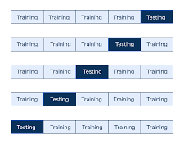
Cross-Validation
What is Cross-Validation?
A technique to evaluate model performance more reliably by splitting data into multiple train-test folds.
Scikit-Learn Function:
from sklearn.model_selection import cross_val_score
scores = cross_val_score(model, X, y, cv=5)
Benefits:
Reduces overfitting risk
Gives a better estimate of generalization
Works with any supervised model
cv=5 means 5-fold cross-validation

Slide 29
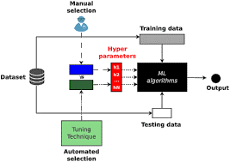
Hyperparameter Tuning
What Are Hyperparameters?
Settings passed before training (e.g., number of neighbors in KNN)
📌 Not learned during training, but significantly impact model performance.
📦 Tuning Methods in Scikit-Learn:
GridSearchCV – Exhaustive search
RandomizedSearchCV – Random combinations
from sklearn.model_selection import GridSearchCV
grid = GridSearchCV(model, param_grid, cv=5)
grid.fit(X_train, y_train)
Find the best combination of parameters

Slide 30
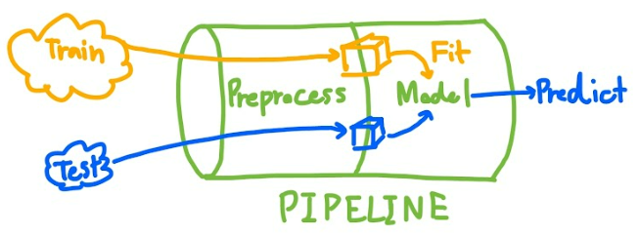
Pipelines in Scikit-Learn
Why Use Pipelines?
Combine multiple steps (e.g., preprocessing + modeling) into a single object.
from sklearn.pipeline import Pipeline
from sklearn.preprocessing import StandardScaler
from sklearn.linear_model import LogisticRegression
pipe = Pipeline([
('scaler', StandardScaler()),
('classifier', LogisticRegression())
])
pipe.fit(X_train, y_train)
✅ Benefits:
Clean code
Reproducibility
Reduces data leakage

Slide 31
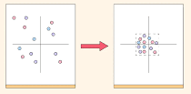
Feature Scaling
Why Scale Features?
Some ML algorithms are sensitive to feature scales (e.g., KNN, SVM, Gradient Descent-based models)
📦 Common Scalers in Scikit-Learn:
StandardScaler: Mean = 0, Std = 1
MinMaxScaler: Scales between 0 and 1
RobustScaler: Handles outliers well
from sklearn.preprocessing import StandardScaler
scaler = StandardScaler()
X_scaled = scaler.fit_transform(X)
⚠️ Always fit scaler only on training data!

Slide 32
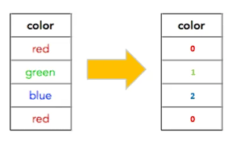
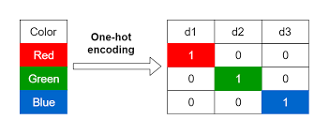
Handling Categorical Data
🔡 Why Handle Categorical Features?
ML models work with numbers, not strings.
📦 Techniques in Scikit-Learn:
LabelEncoder: Converts labels to numbers
OneHotEncoder: Creates binary columns for each category
from sklearn.preprocessing import OneHotEncoder
encoder = OneHotEncoder()
X_encoded = encoder.fit_transform(X_categorical)
🧠 Use ColumnTransformer to apply encoders selectively in pipelines.

Slide 33
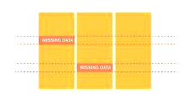
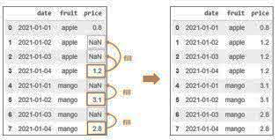
Handling Missing Data
🚫 Why Handle Missing Values?
Missing values can break model training or reduce accuracy.
📦 Scikit-Learn Solution: SimpleImputer
from sklearn.impute import SimpleImputer
imputer = SimpleImputer(strategy='mean') # or 'median', 'most_frequent'
X_imputed = imputer.fit_transform(X)
🧠 Strategies:
Mean/Median for numerical data
Most frequent for categorical data
Constant value (e.g., 0 or “Unknown”)
🔄 Use in Pipelines for automation!

Slide 34


Saving and Loading Models
💾 Preserve Trained Models for Later Use
📦 Using joblib (preferred for sklearn objects):
import joblib
# Save model
joblib.dump(model, 'model.pkl')
# Load model
model = joblib.load('model.pkl’)
✅ Useful for:
Reuse without retraining
Deployment in production systems
Sharing models with others

Slide 35

Real-World Project Example
📊 Use Case: Predicting House Prices
Steps:
Load dataset (e.g., Boston Housing)
Preprocess features (scale, handle missing)
Split into train/test sets
Train LinearRegression model
Evaluate using MSE & R²
Tune hyperparameters (if needed)
Save final model
🧠 Combines: Regression, Preprocessing, Pipeline, Evaluation
📦 Encourages end-to-end ML workflow using Scikit-Learn

Slide 36


Integration with Other Libraries
🔗 Scikit-Learn Works Seamlessly With:
📦 NumPy – Numerical arrays
📊 Pandas – DataFrames for structured data
📉 Matplotlib / Seaborn – Visualization
🔍 XGBoost, LightGBM – Advanced models using sklearn API
🧠 TensorFlow / PyTorch – Deep learning + sklearn for preprocessing
📦 Many tools are Scikit-Learn compatible via .fit() / .transform() API
🤝 Scikit-Learn = Core of the Python ML ecosystem

Slide 37


Common Challenges & Best Practices
⚠️ Common Pitfalls:
Not scaling data when needed
Data leakage (using test data in training)
Overfitting from too complex models
Ignoring class imbalance
✅ Best Practices:
Use Pipelines to prevent leakage
Apply Cross-Validation for reliable metrics
Tune hyperparameters systematically
Monitor overfitting with validation set
Document & version control your models

Slide 38


Summary and Final Thoughts
📌 Key Takeaways:
Scikit-Learn is a powerful, easy-to-use ML library in Python
Supports full ML pipeline: preprocessing → modeling → evaluation → deployment
Offers a wide range of algorithms for both supervised and unsupervised learning
Encourages best practices via pipelines, cross-validation, and grid search
Integrates well with tools like Pandas, NumPy, Matplotlib, and joblib
🎯 Next Steps:
Explore real datasets
Try out various models
Build and deploy your own ML project!

Slide 39
THANK YOU

